Slide 1
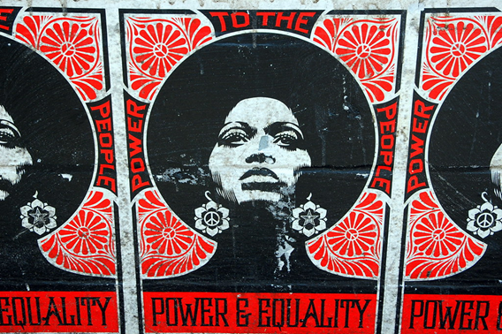
Power, domination and exploitation

Slide 2
Power (Allen 2021)
2 approaches to understanding power: (i) as getting someone else to do what you want them to do (power-over others) vs. (ii) as an ability or a capacity to act, “energy and competence” (power-to do something) – both dispositional
Micro-level individual-relational vs. macro-level structural power
Mirrlees (2020): relational: governing with tactics of persuasion and coercion to get subjects to act in concordance with preferred ends; structural: ownership and control of capital resources and resource allocation, and influence on State decisions about public law, policy and regulation
Power as resource (a social good that is distributed unfairly), as domination (unjust/illegitimate power-over relation) or creative-productive (bringing about social realities)?
Foucault: constantly shifting set of relations that emerge from social interactions and shape the social body
Important element in Foucauldian “disciplinary power”: surveillance and internalised self-surveillance

Slide 3
Domination (McCammon 2018)
Latin “dominus” = master
Domination as power over others, based on asymmetries in power – including interference with their choices or conditions of their actions
Dominating power is usually in some sense unconstrained and can be arbitrary and performed with impunity
Relationships of domination are generally recognised as morally unjust or illegitimate
Individual persons (or companies) can be dominating; systems/ideologies as providing the conditions for/ facilitating domination
Marxism: domination results from capitalist appropriation of the surplus value produced by the workers
Background power structures of domination can be in place even when dominator happens to behave seemingly benevolently and the dominated get what they want

Slide 4
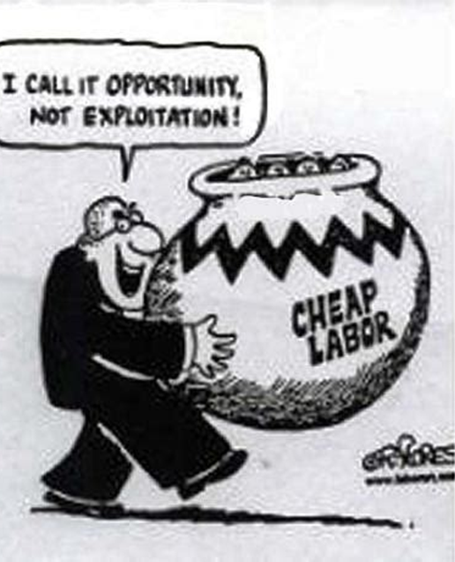
Exploitation (Zwolinski & Wertheimer 2016)
taking unfair advantage of someone
using someone’s vulnerability for one’s own benefit, and leaving them worse off than they should have been (can be better than before but not “good enough”)
Requires power differential and dominance by exploiter
compatible with someone voluntarily seeking out exploitative set-up (e.g. if exploitative jobs are the only ones available and “better than nothing”)
exploitation can be transactional (particular exploitative interaction between two parties) or structural (system designed to exploit)
Marxism as one of the most prominent theories of exploitation: value extraction from workers for payment significantly below the value of their labour (“forced appropriation by capitalists of the surplus value produced by workers”)

Slide 5

Power in digital ecosystems –market concentration and its consequences

Slide 6

GAFAM (AAMAM)
GAFAM: 5 large internet companies: Google (Alphabet), Amazon, Facebook (Meta), Apple, Microsoft
Mirrlees 2020: “GAFAM’s power is manifested by their outsized market value, market capitalization, net income and revenue, mergers and acquisitions, market share, intellectual property (IP), and CEO wealth”
Over 6.4 trillion $ market capitalisation
Between 2014 and 2019, GAFAM integrated nearly 250 companies from across the communications and digital hardware, software and service sectors
Google and Facebook alone take around 60% of global digital advertising – 87% of Google’s and 98% of FB income from advertising

Slide 7
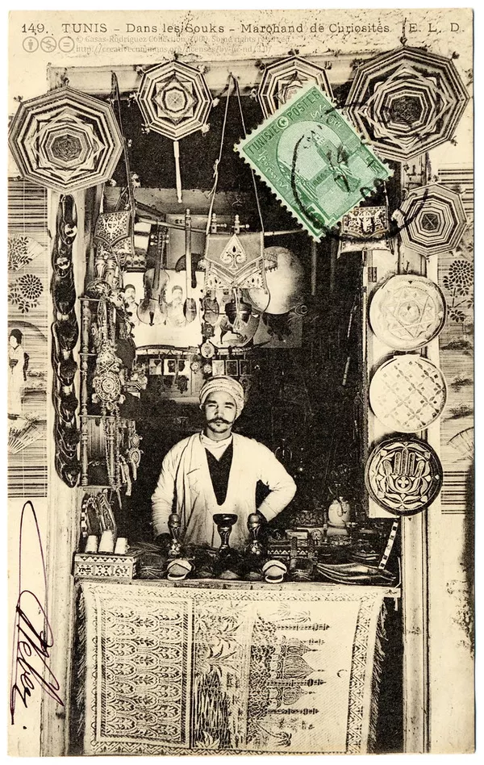
Digital services, platforms and ecosystems
Service: provision of one defined, specific set of services to customers
Platform: variety of users are brought together on a platform, e.g. service users and service providers – that platform might be a monopolist in its field
Digital ecosystem: a company provides a wide variety of expanding interlocking services that keeps service users drawing on comprehensive services within the ecosystem, without perceived need (or feasibility) for engagement with competitors

Slide 8
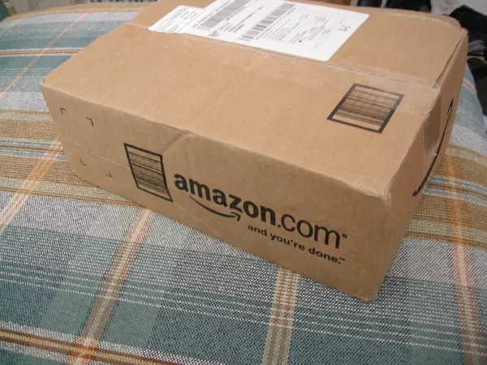
Establishing dominance – Amazon as example
Forgoing profits and moving aggressively to establish dominance (network effects) – rewarded by valuations
E.g. providing e-books below cost; transport below cost; delisting of Hachette books during business dispute
Expansion into multiple business lines with increasing interconnections to establish ecosystem
“In addition to being a retailer, it is a marketing platform, a delivery and logistics network, a payment service, a credit lender, an auction house, a major book publisher, a producer of television and films, a fashion designer, a hardware manufacturer, and a leading provider of cloud server space and computing power” (Khan 2017, p.713)

Slide 9
What is the problem with dominance?
What is the problem if consumers are benefitting after all?
monopoly and lack of competition currently not affected by regulation due to anti-trust law’s focus on consumer welfare, usually understood as price level
Khan’s claim: underlying structure and dynamics of markets needs to be taken into account when considering whether a company’s conduct is problematic.
“Rather than pegging competition to a narrow set of outcomes, this approach would examine the competitive process itself. Animating this framework is the idea that a company's power and the potential anticompetitive nature of that power cannot be fully understood without looking to the structure of a business and the structural role it plays in markets. Applying this idea involves, for example, assessing whether a company's structure creates certain anticompetitive conflicts of interest; whether it can cross-leverage market advantages across distinct lines of business; and whether the structure of the market incentivizes and permits predatory conduct.” (p.717)

Slide 10

The problem of monopolies
Structuralist, politically oriented position (accepted until 1960s; then rise of Chicago School which focused predominantly on materialist considerations, especially consumer pricing as criterion)
Khan (2017, 2018) argues for a return to these core ideas to address current challenges especially in digital sphere)
“(1) monopolistic and oligopolistic market structures enable dominant actors to coordinate with greater ease and subtlety, facilitating conduct like price-fixing, market division, and tacit collusion;
(2) monopolistic and oligopolistic firms can use their existing dominance to block new entrants; and
(3) monopolistic and oligopolistic firms have greater bargaining power against consumers, suppliers, and workers, which enables them to hike prices and degrade service and quality while maintaining profits.” (Khan 2017, p.718)

Slide 11
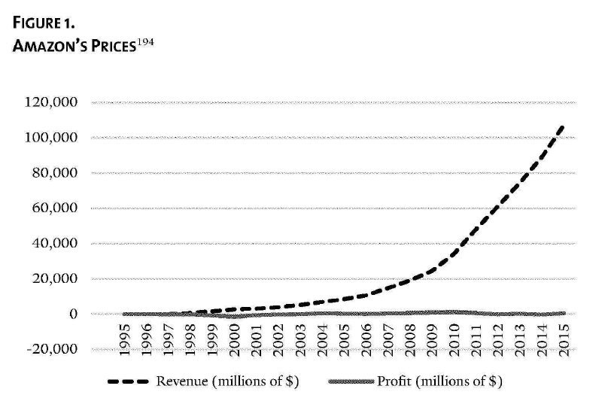
Predatory pricing and vertical integration
Predatory pricing: to force competitors out, facilitated by size or underlying valuations
Vertical integration: when “two or more successive stages of production and/or distribution of a product are combined under the same control”, to use leverage in one area of dominance to exert beyond this area

Slide 12
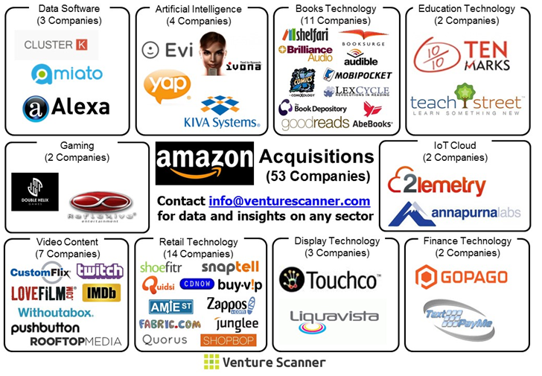
Acquisitions and valuation
Over 600 acquisitions between 2010 and 2019 in GAFAM, some of which were “killer acquisitions” (acquisitions of potential competitors with the purpose to prevent those companies from successfully challenging the incumbents)
Google 220, Amazon 86, Microsoft 175
Australian Competition Authority:
50-67% of 2019 share price for Facebook and 46-64% for Google can be attributed to expectations for future growth (i.e. further expansion and entrenchment of power)

Slide 13

Lock-in effects
E.g. Amazon’s e-book pricing and Kindle devices:
“Compelling readers to purchase a Kindle through cheap e-books locks them into future e-book purchases from Amazon. Moreover, buying-or even browsing-e-books on Amazon's platform hands the company information about your reading habits and preferences, data the company uses to tailor recommendations and future deals. Replicated across a few more purchases, Amazon's lock-in becomes strong. It becomes unlikely that a reader will then purchase a Nook and switch to buying e-books through Barnes & Noble, even if that company is slashing prices.” (Khan 2017, p.760-61)
At the same time inventing new fees to publishers for what was previously standard service, based on dominance in market

Slide 14

Why focus on market structure and prospective concerns over current pricing outcomes?
Longer term risks of domination associated with concentrated markets
Early timing is essential:
“it is much easier to promote competition at the point when a market risks becoming less competitive than it is at the point when a market is no longer competitive”
“allowing firms to amass market power makes it more difficult to meaningfully check that power when it is eventually exercised. Companies may exploit their market power in a host of competition-distorting ways” (p. 745)
Interests beyond prices as indicator of consumer welfare – e.g. innovation:
“allowing a highly concentrated market structure to persist endangers … long-term interests, since firms in uncompetitive markets need not compete to improve old products or tinker to create news ones” (p.739)
“Sustaining” rather than constructively “disruptive” innovation

Slide 15
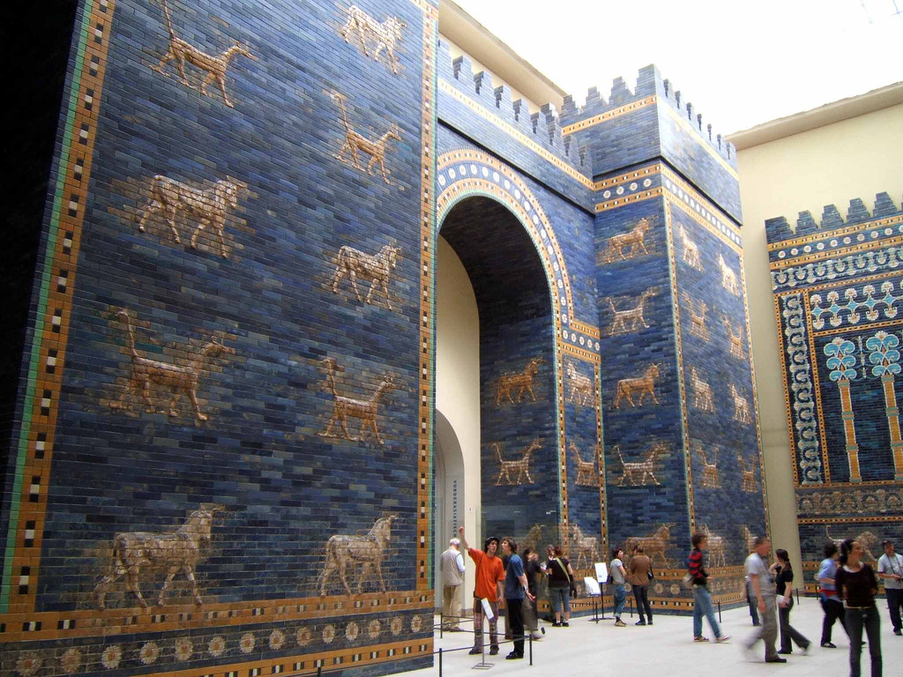
Concerns associated with market concentrations in general
(1) entry barriers
(2) conflicts of interest
(3) the emergence of gatekeepers/bottlenecks
(4) the use of and control over data
(5) the dynamics of bargaining power

Slide 16

Types of platform power (Khan 2018)
Gatekeeper power, i.e. necessary intermediaries with power of extortion
“these companies serve effectively as infrastructure for digital markets - they are distribution channels, the arteries of commerce” (p.326)
Leveraging of platform dominance: for advantageous self-positioning, including in separate or ancillary markets
Information exploitation: of huge amount of data, including from 3rd party websites, e.g. for discrimination or competition

Slide 17

Example Gatekeeping
Epic (Fortnite) vs Apple App Store 2020-2021
Focused on mandatory 30% cut of all sales through App Store and prohibition on including alternative payment pathways in app information (and similar on Google Play)
Argued that Apple (and Google) abused their gatekeeping power to take oversight of app details to retain their unreasonably high profits which appeared disproportionate to actual expense (unlike hardware related gaming market)
(California courtcase: 9/10 in favour of Apple, partly based on specific definition which market was affected, but siding with Epic on payment pathways)

Slide 18


Examples: Information exploitation
Facebook and Onavo:
Purchased Onavo, provider of VPN app, used to follow users’ activity across the internet
Understanding what users did across their mobile activities allowed FB to identify WhatsApp as a emerging threat
Deceptive presentation of Onavo as VPN that helped users control their internet use, but analysing all traffic and employing that knowledge to further strengthen their own position
Amazon vs. Quidsi (diaper.com)
Quidsi offered a nappy buyers’ programme (as well as other beauty products) through Amazon
Amazon noticed its success, provided loss-making low pricing that undercut Quidsi, and left the company little financial possibility to resist acquisition. Once it had been bought, prices rose again

Slide 19

Leveraging dominance: Google Search, and the positioning of own ads/services
Fine against Google imposed by European Commission in 2018 for set of anticompetitive restrictions on manufacturers of mobile devices and network operators
‘distribution agreements’, requiring manufacturers of mobile devices to pre-install the general search (Google Search) and (Chrome) browser apps in order to be able to obtain a licence from Google to use its app store (Play Store)
‘anti-fragmentation agreements’, under which the operating licences necessary for the pre-installation of the Google Search and Play Store apps could be obtained by mobile device manufacturers only if they undertook not to sell devices running versions of the Android operating system not approved by Google;
‘revenue share agreements’, under which the grant of a share of Google’s advertising revenue to the manufacturers of mobile devices and the mobile network operators concerned was subject to their undertaking not to pre-install a competing general search service on a predefined portfolio of devices.
Resulting in EUR 4.3 billion fine
https://curia.europa.eu/jcms/upload/docs/application/pdf/2022-09/cp220147en.pdf

Slide 20
Solutions to power uses?
Gatekeeping power: if infrastructure is essential for domain, maintaining structural benefits of network monopoly, but constrain abuse of power by requiring “common carriage” or platform neutrality, including equal access, transparent and consistent pricing (digital: “net neutrality”)
Leveraging power: requirement to restructure and separate conflicting parts (e.g. split company into platform provider and competitor; operating system and apps that run on system)
Information exploitation: challenging and novel, due to surveillance-based business models – might require restricting allowable use of information; structuring competition regarding new acquisitions or undoing old acquisitions; even ending surveillance-based business models altogether?

